Slide 1


AIRLINE FLIGHT STATUS PREDICTION
Group Member: Ashley Sun, Daisy Dai, Katarina Wang. Yichen Yang, Yijia Song

Slide 2
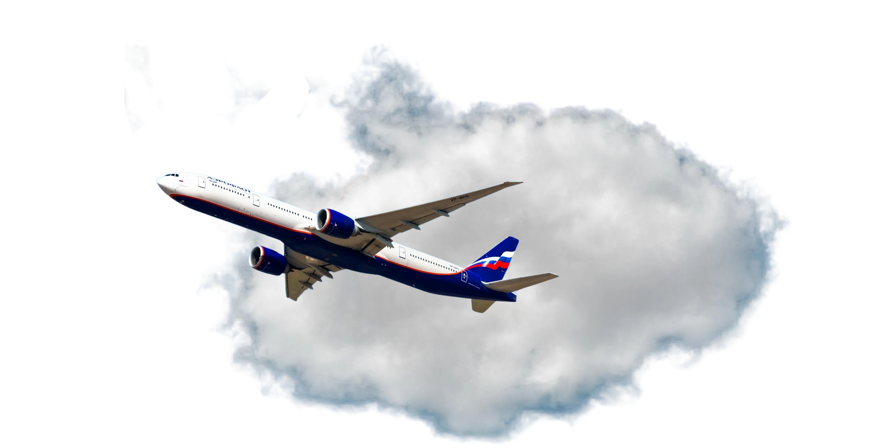
TABLE OF CONTENT
PROJECT OVERVIEW EDA MODELS BUILDUP BUSINESS INSIGHTS
01.
02.
03.
04.
Project Overview
Exploratory & Data Analysis
Models Buildup & Graph Analysis
Business Insights

Slide 3


INTRODUCTION
PROJECT OVERVIEW EDA MODELS BUILDUP BUSINESS INSIGHTS
PROBLEM
PROJECT
The airline industry faces significant challenges from delays and cancellations, with 20% of U.S. flights delayed and 2% canceled in 2022, costing airlines over $8 billion annually.
These disruptions also severely impact customer satisfaction, as punctuality is a top priority for 80% of passengers, and they strain operational efficiency through increased costs and logistical issues.
This project examines historical flight data to uncover patterns and drivers of delays and cancellations
To analyze flight data to identify factors influencing delays and cancellations.
To build predictive models for flight status (on-time, delayed, cancelled).
To provide actionable insights for both consumers and airlines’ operations.

Slide 4
Dataset Overview
PROJECT OVERVIEW EDA MODELS BUILDUP BUSINESS INSIGHTS
Airline Delay and Cancellation Data (2009-2018)
Flight Delay Dataset (2018-2022)
Flight Delay and Cancellation Data (2019-2023)
This dataset offers a comprehensive overview of flight delays and cancellations over a decade, from 2009 to 2018.
Key features include flight dates, origin and destination airports, delay durations, and reasons for cancellations, providing valuable insights into long-term trends in airline performance.
This dataset provides detailed flight delay and cancellation data from 2018 to 2022, capturing key trends and performance metrics in the airline industry.
Variables include flight date, carriers, flight time information (depature and arrival time) , flight status etc.
This dataset covers flight delays and cancellations from 2019 to 2023, reflecting recent trends in the airline industry, including the impact of the COVID-19 pandemic.
Variables include flight routes (origin, destination), time ranges for events (minutes, local time), delay and cancellation reasons/attributions (limited).

Slide 5
ANALYSIS I.
Exploratory & Data Analysis

Slide 6
Flight Status Classification
PROJECT OVERVIEW EDA MODELS BUILDUP BUSINESS INSIGHTS
ONTIME
A flight is considered on time if it arrives at its destination within 15 minutes of the scheduled arrival time, regardless of whether it departed on time or slightly late.
DELAYED
A flight is considered delayed if it arrives more than 15 minutes late, whether it departed on time or late.
Flights scheduled to operate but did not take off
CANCELLED
Flights unable to reach destination and is rerouted to land at a different airport from destination
DIVERTED
Notes:
we’re covering flight status classifications for further analysis.
First, we have ontime flights. These are flights that arrive within 15 minutes of the scheduled time, no matter if there was a slight delay at departure. This is the goal for any airline—punctuality matters.
Then, we have delayed flights. These are flights that arrive more than 15 minutes late, regardless of when they took off. Delays can stem from a variety of issues—weather, technical problems, or operational hiccups—and they need to be communicated clearly to passengers.
There’s also a category for flights that didn’t take off. This includes cancellations or significant issues that prevent a flight from operating. In these cases, quick communication about rebooking options is key.
Lastly, we have rerouted flights—flights that are unable to reach their original destination and are diverted to another airport. This could happen due to bad weather or safety concerns, and again, passengers need to be kept in the loop about any changes.

Slide 7
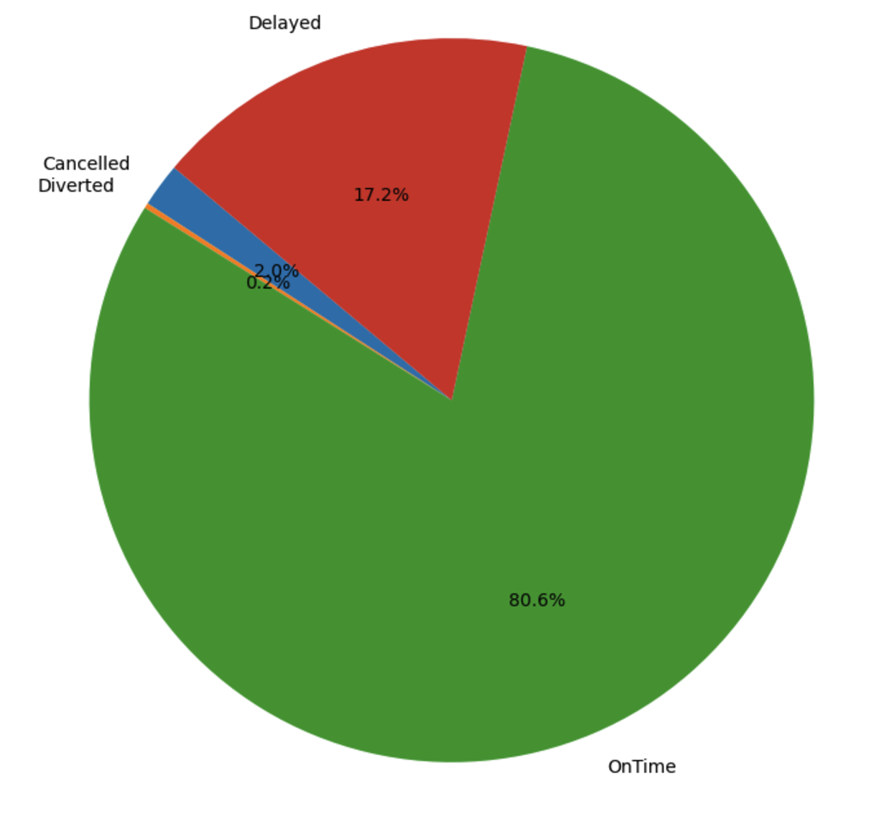

Flight Status Distribution
PROJECT OVERVIEW EDA MODELS BUILDUP BUSINESS INSIGHTS
OnTime
Delayed
80.06% (62025662 cases)
17.2% (13256269 cases)
Cancelled
Diverted
2.0% (1508474 cases)
0.2% (179145 cases)
Most of flights arrive on time (80%)
Delays account for 90% of abnormal flights.
The data imbalance is significant:
the cancelled and diverted entities didn't exceed 5%, so we chose to exclude them in the machine learning part.
Notes:
On this slide, we can see the distribution of flight statuses across the dataset.
OnTime: As expected, a large portion of flights (80%) are on time, which shows that most flights reach their destination as scheduled.
Delayed: Delays make up 17.2% of the data, and these account for about 90% of the abnormal flight statuses. This is a critical area for airlines to focus on in terms of operational efficiency.
Cancelled: Only 2% of flights are cancelled, which is a relatively small proportion, but still significant in terms of customer impact.
Diverted: A very small portion of flights (0.2%) are diverted, indicating that rerouting is a rare but important occurrence for safety or weather-related reasons.
Data Imbalance: Notice that there is a clear data imbalance, with the cancelled and diverted flights representing less than 5% of the total cases. Due to this imbalance, we have chosen to exclude these smaller categories from the machine learning models to focus on more impactful data (ontime vs. delayed). This helps improve model performance by reducing noise.
In conclusion, most flights are on time, but delayed flights are a key focus area in the dataset due to their higher frequency of occurrence.

Slide 8
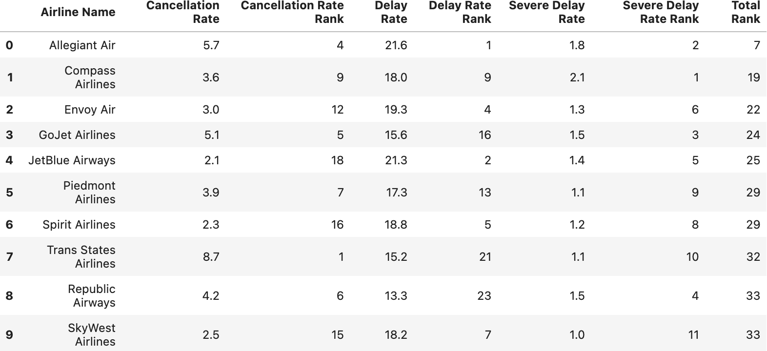
Cancellation/Delay Rate By Airline
PROJECT OVERVIEW EDA MODELS BUILDUP BUSINESS INSIGHTS
Top 10 Airlines most frequently delay:
Allegiant Air;
JetBlue Airways;
Spirit Airlines;
Skywest Airlines;
Positive correlation between delay rate & severe delay rate
Airlines having minor delays probably delay severely
*Besides heatmap, we also use ranking to investigate the potential correlation as the first step.
Key Terms:
Delayed: >15 minutes late.
Severe Delayed: >3 hours late.
Notes:
Now, let's take a look at the cancellation and delay rates by airline. We’re looking at the performance of the top 10 busiest airlines, which we’ve identified through our dataset based on the volume of flight records. These airlines have the most flights, so understanding their cancellation and delay rates is crucial for improving the overall travel experience. Allegiant Air, for example, ranks high in cancellations and delays, which may be linked to the large number of flights it operates.
Airlines with higher minor delays are more likely to experience more severe delays. This pattern is more pronounced among the busiest airlines, suggesting that better management of minor delays could possibly prevent bigger disruptions and improve overall performance.
Finally, note that the total rank combines all factors into one final ranking, where lower numbers indicate worse performance. This ranking provides an overall view of which airlines need more focus to improve punctuality and reduce delays.

Slide 9
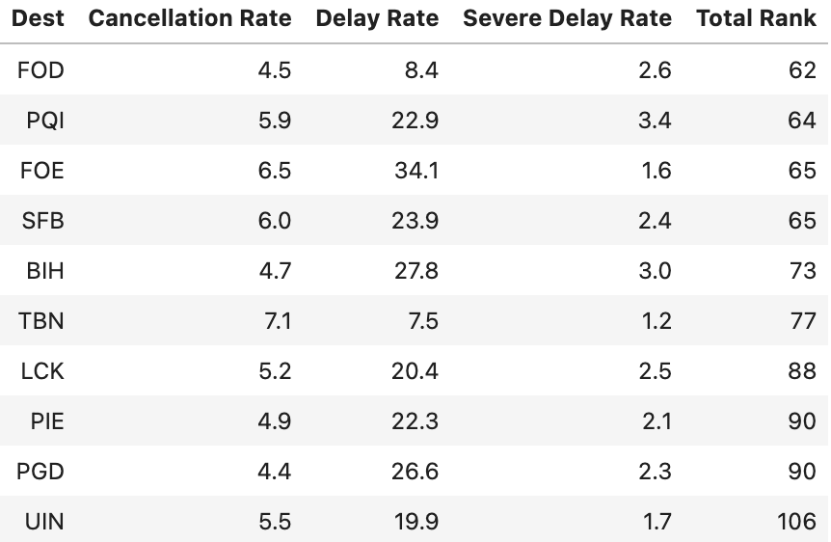
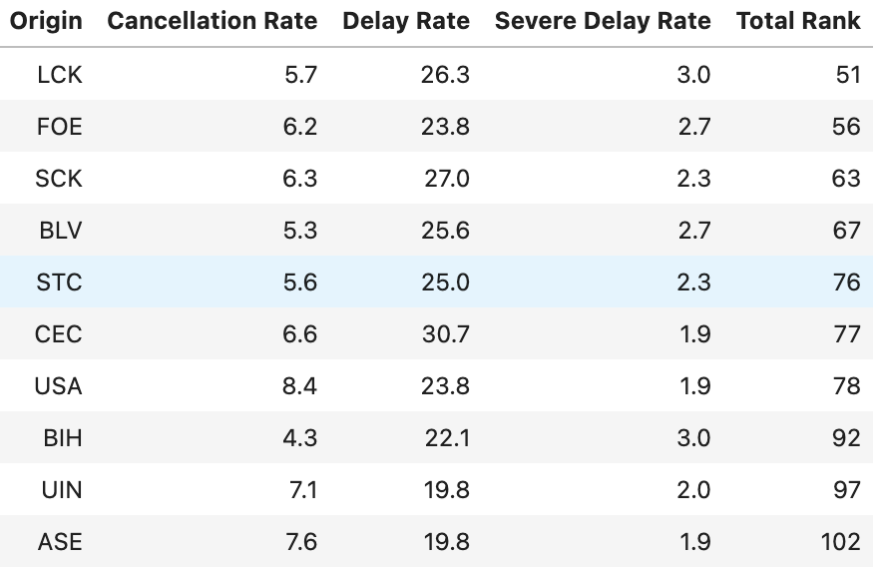
Cancellation/Delay Rate By Airport
PROJECT OVERVIEW EDA MODELS BUILDUP BUSINESS INSIGHTS
Finding:
We found that there are overlaps between the delayed departing and arriving airports.
FOE; SFB; BIH
Possible reasons: operational chaos
Notes:
So here we’re looking at cancellation and delay rates for different airports—destinations on the left, origins on the right. What really stands out is that some airports, like FOE, SFB, and BIH, have high delay rates both as departure and arrival points. This suggests some underlying issues, maybe operational or weather-related.

Slide 10
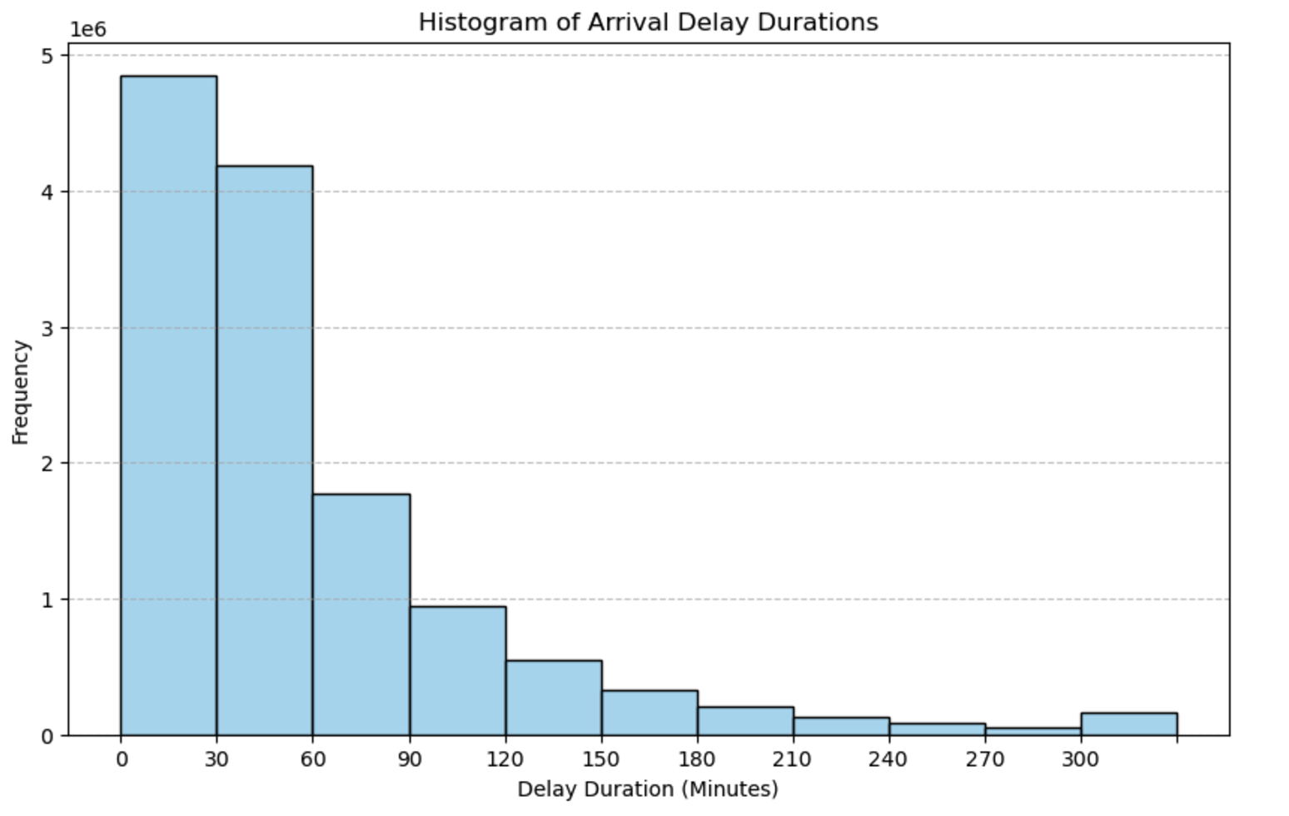
Distribution of Delay Durations
PROJECT OVERVIEW EDA MODELS BUILDUP BUSINESS INSIGHTS
Heavily skewed to the right
majority of delays are within 1 hour
Notes:
This histogram shows the distribution of delay duration. We can see that the graph is heavily skewed to the right, indicating that most delays are relatively short, typically under one hour. Delays longer than 1 hour are much less common.

Slide 11
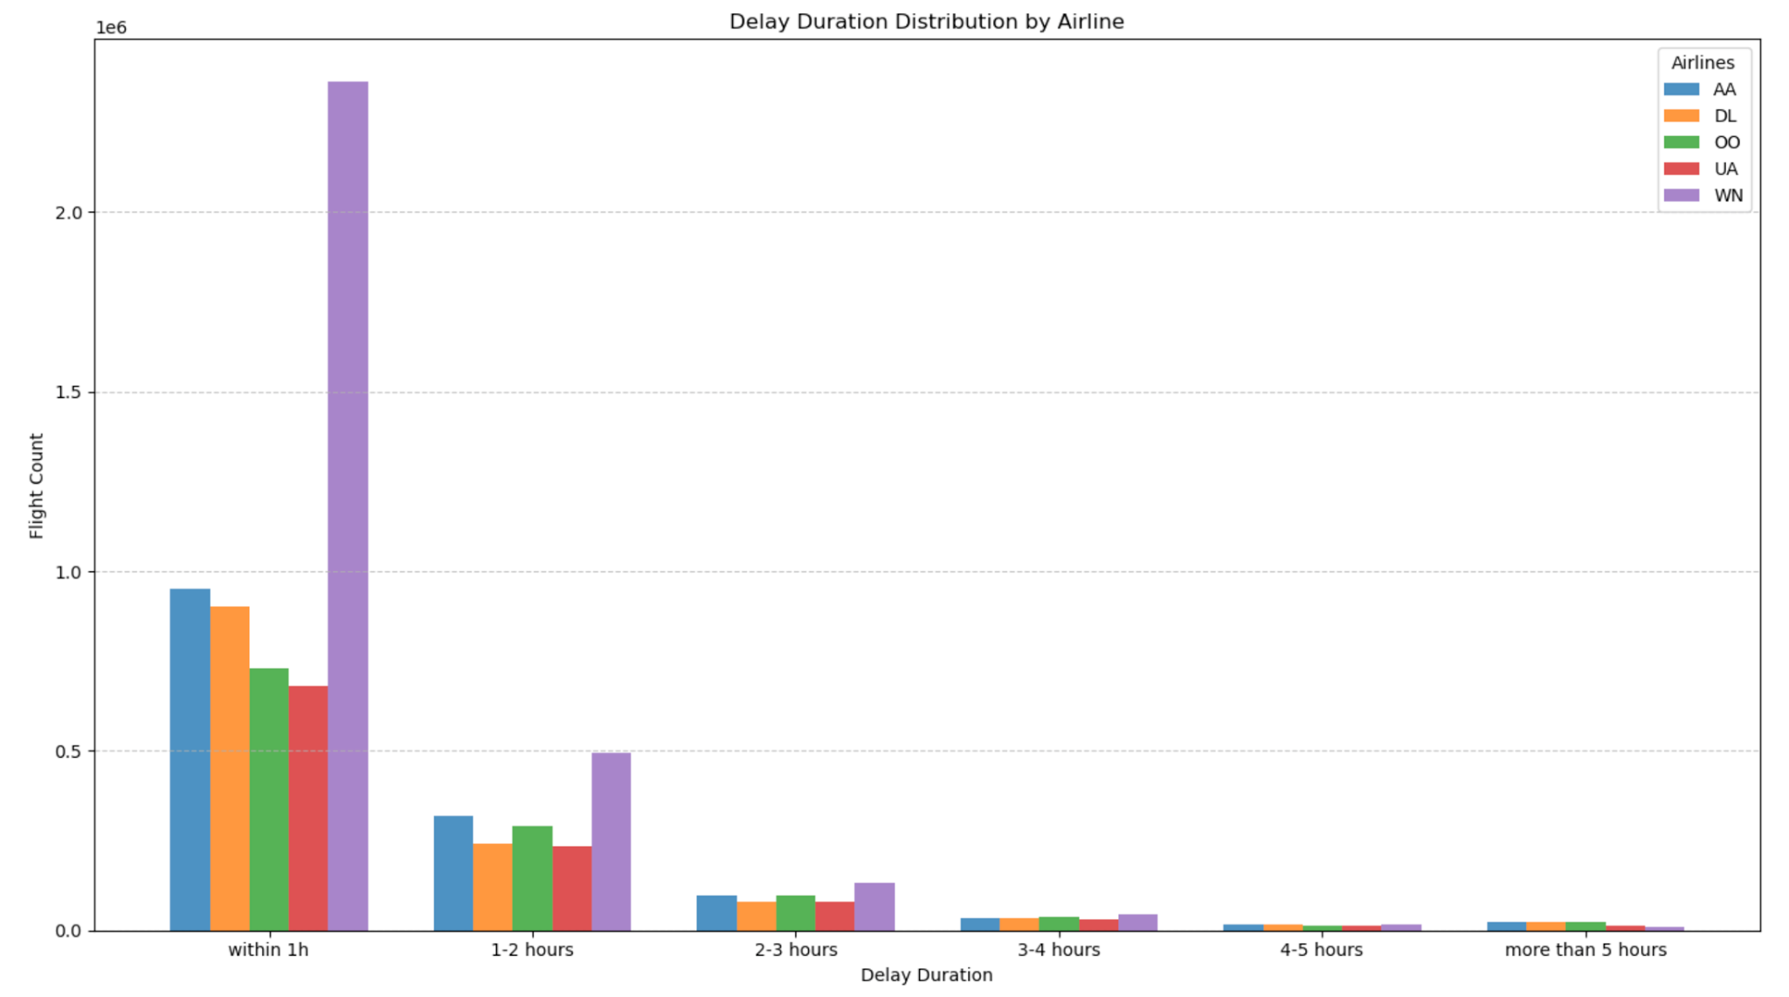

Delay Duration by Airline
PROJECT OVERVIEW EDA MODELS BUILDUP BUSINESS INSIGHTS
Top 5 Largest Airlines
Southwest (WN)
Delta (DL)
American Airline (AA)
Skywest (OO)
United Airline (UA)
Notes:
Then we identified the top 5 largest airlines by the number of flights they operated.
We found that delay durations follow the same trend. Most delays are under 1 hour, and there is a notable decline in frequency in the next time range

Slide 12
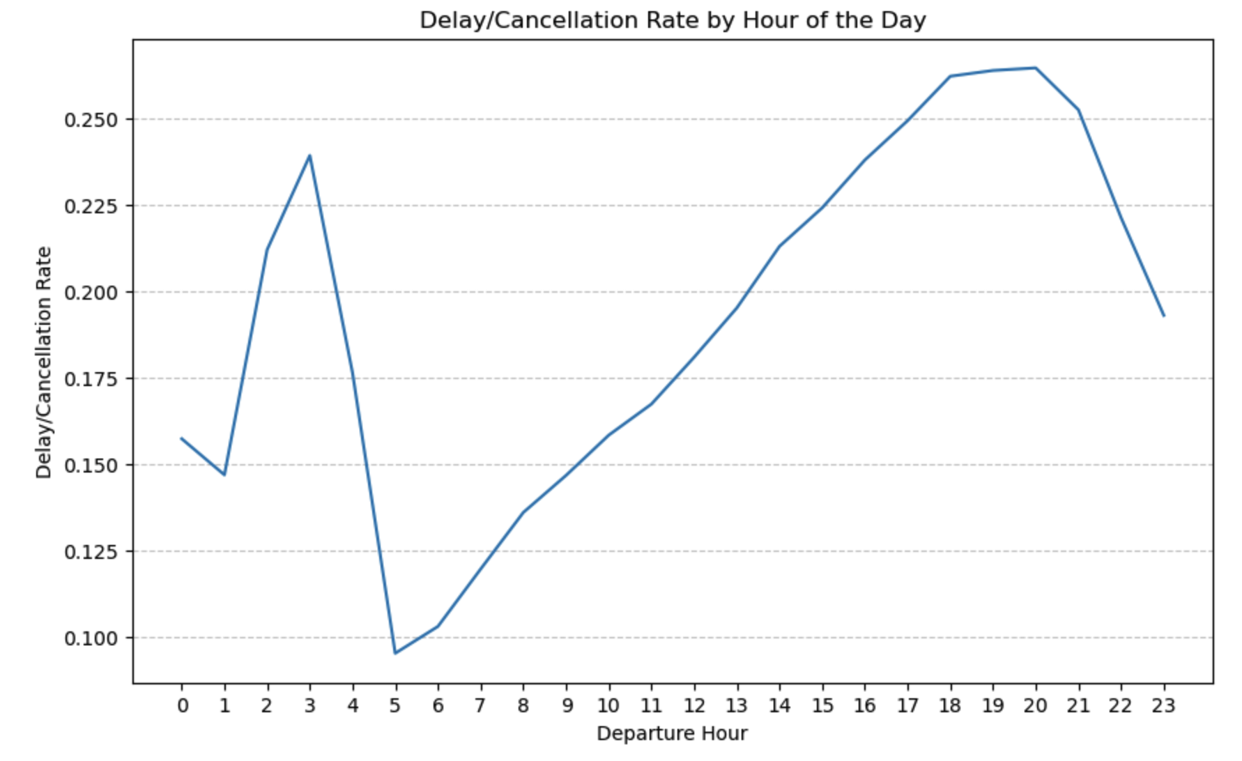
Peak Times of Delay
PROJECT OVERVIEW EDA MODELS BUILDUP BUSINESS INSIGHTS
Peak hours:
Midnight: ~3am
Night time: ~ 6pm - 9pm
Off-peak hours:
Morning: 5am - 6am
Notes:
This chart shows the peak times for delays and cancellations during the day. The x-axis represents the flight departure time. We observe two peaks in the graph: one is around 3 a.m, and the other one happens during the evening times, from 6pm to 9pm. Delays are least frequent for the early morning flights that depart from its origin around 5am. to 6am.

Slide 13
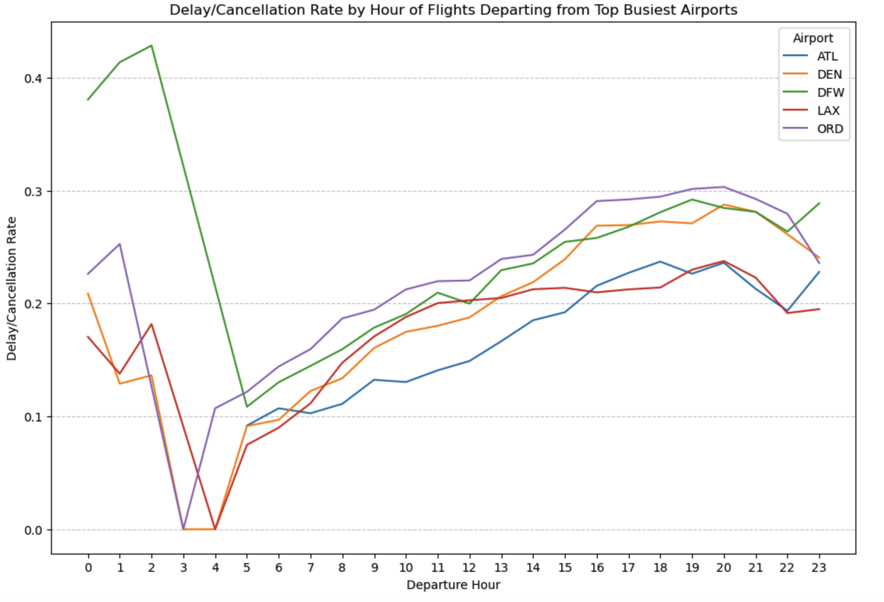
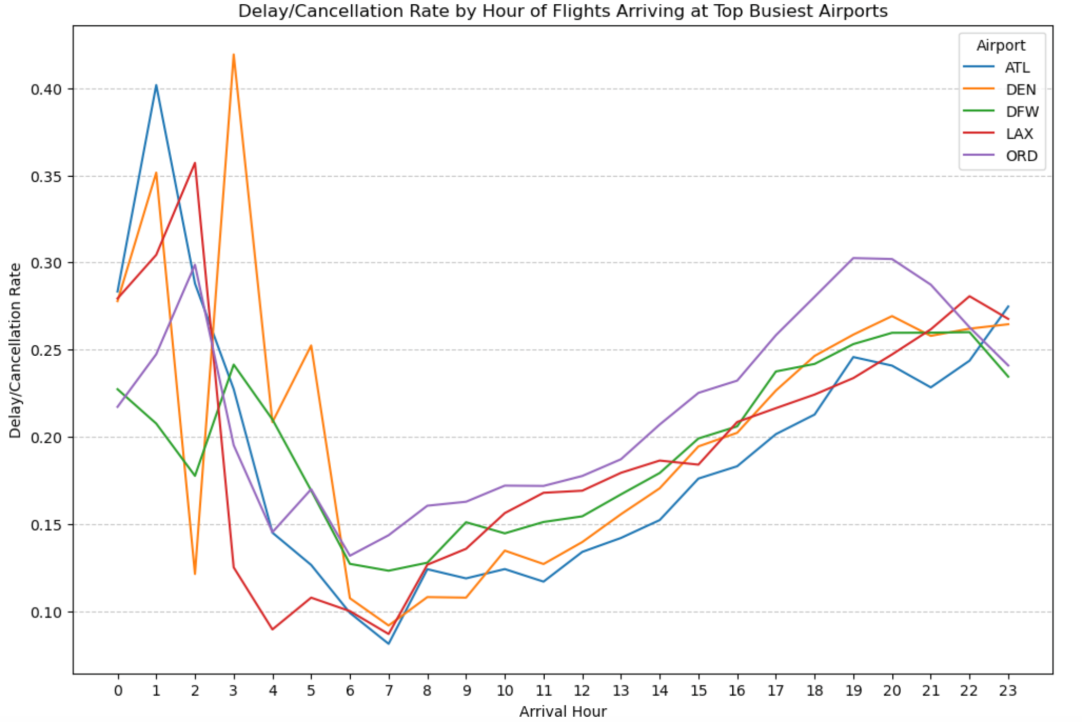
Peak Times of Delay By Airport
PROJECT OVERVIEW EDA MODELS BUILDUP BUSINESS INSIGHTS
By airport where the flight is departing from
By airport where the flight is arriving at
Departure Hour
Arrival Hour
Top 5 Busiest Airports
High Delay Periods
Midnight–3 AM, 6–8 PM
Midnight–3 AM, 6–8 PM
Atlanta (ATL)
Denver (DEN)
Dallas (DFW)
Los Angeles (LAX)
Chicago (ORD)
Lowest Delay Rates
Early morning (3–5 AM)
Early morning (6–7 AM)
Passengers can avoid booking peak-hour flights to reduce the risk of delays and cancellations.
Notes:
We also identified the top 5 busiest airports based on the volume of incoming and outgoing flights. The graph on the left shows the delay/cancellation pattern for flights departing from the top 5 airports, and the right graph shows flights arriving at these 5 airports.
From the green boxes, we can see that there is a slight shift in off-peak arrival times compared to departure times, but this makes sense because it takes a few hours for a flight to reach its destination. Other than that, there are still very similar trends. For passengers who want to minimize the risk of delays and cancellation, they can choose early morning flights, or avoid booking flights that depart or arrive during peak hours.

Slide 14
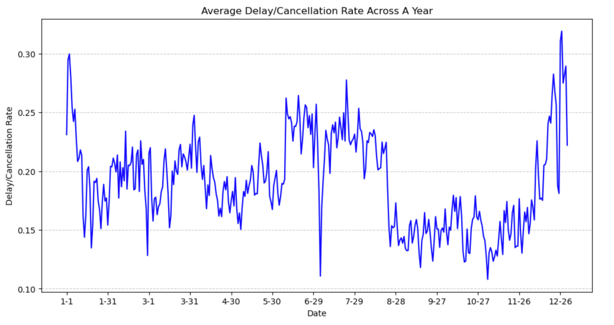
Peak Seasons of Delay
PROJECT OVERVIEW EDA MODELS BUILDUP BUSINESS INSIGHTS
Delays peak during late December–early January (holiday season) and June–August (summer travel).
Off-peak seasons, such as September–November, experience significantly lower delay rates.
Notes:
We then analyzed the average delay/cancellation rates across a year. Peak seasons are observed during the holiday period from late December to early January and the summer months from June to August, likely due to increased travel demand. Of passengers And September to November experienced lower delay rates.

Slide 15
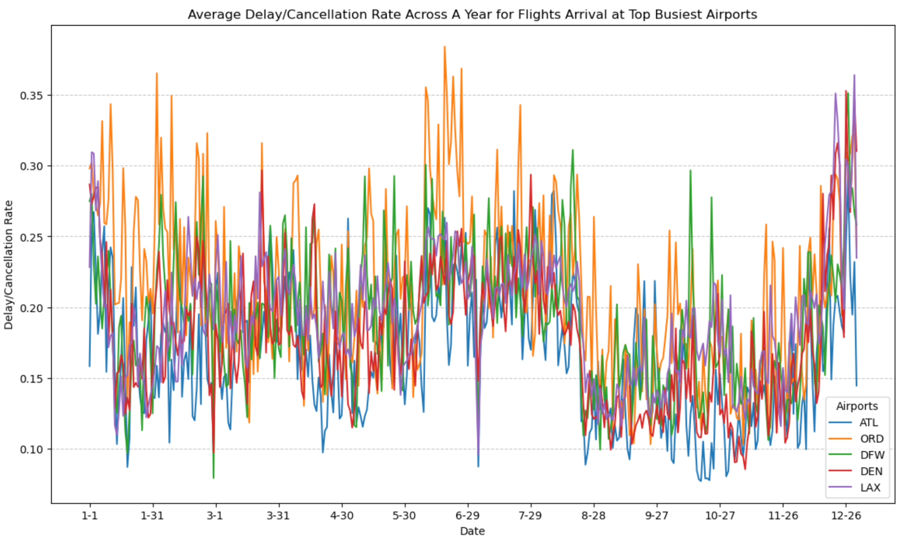
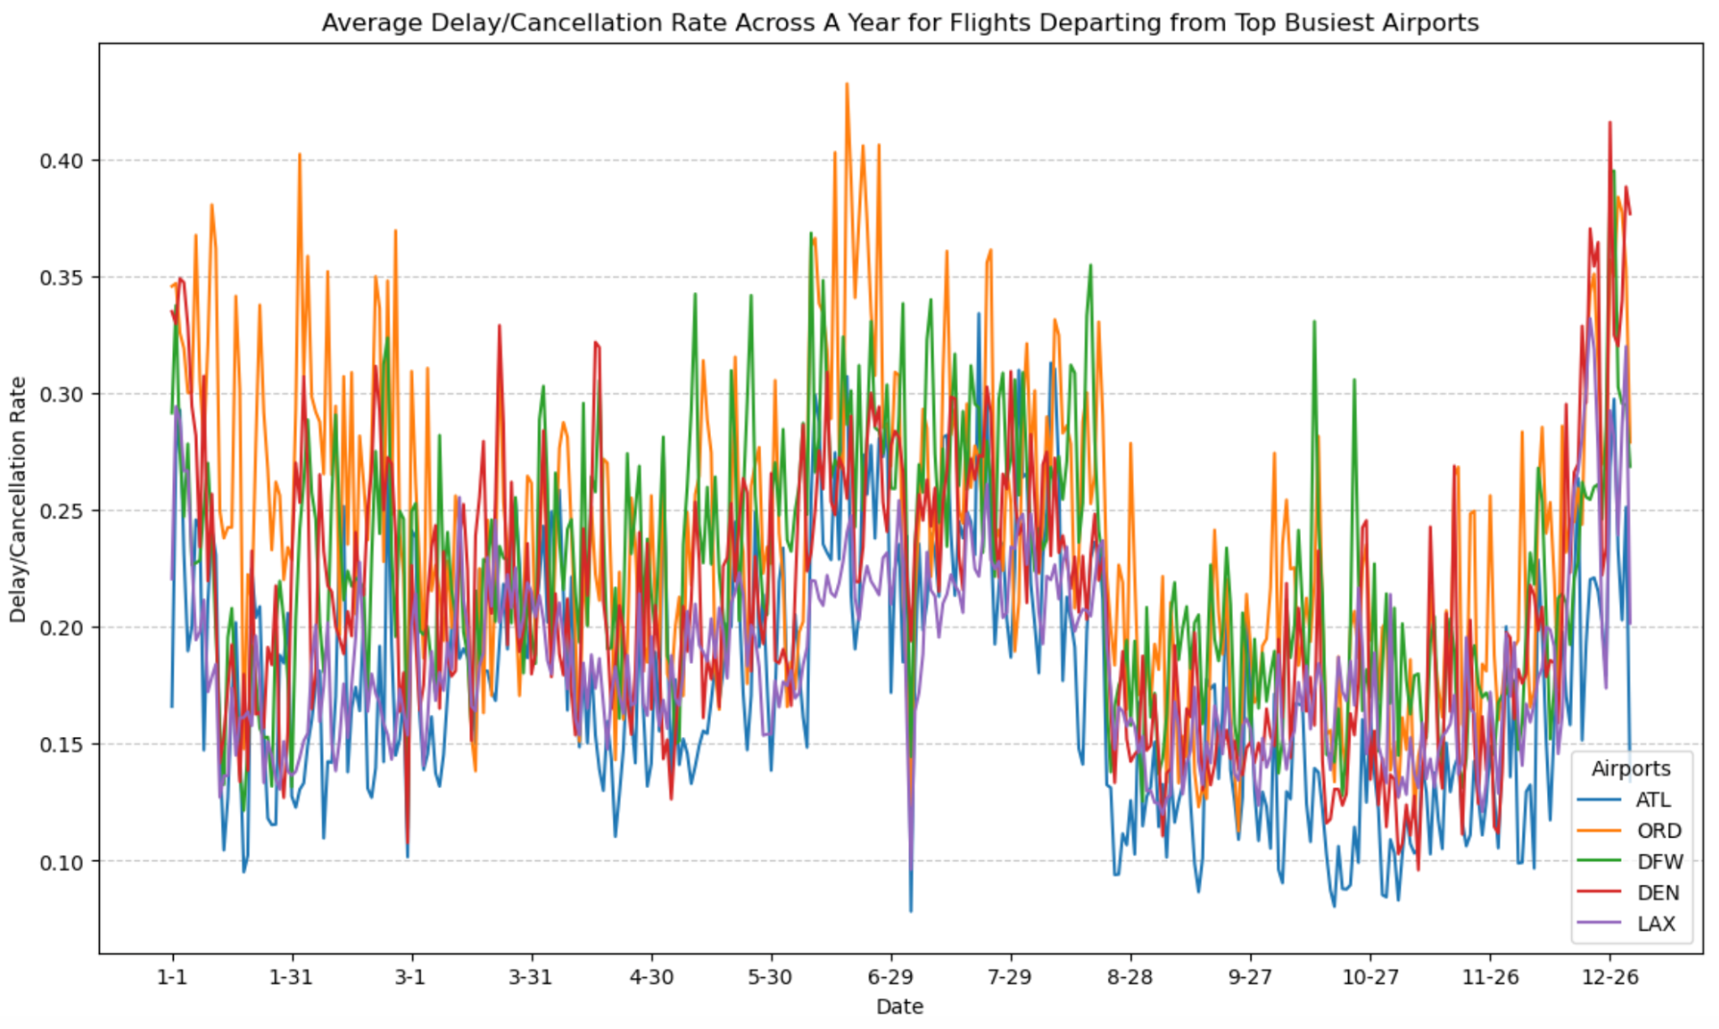
Peak Seasons of Delay By Airport
PROJECT OVERVIEW EDA MODELS BUILDUP BUSINESS INSIGHTS
By airport where the flight is departing from
By airport where the flight is arriving at
Departure Time
Arrival Time
Top 5 Busiest Airports
High Delay Periods
Dec - Jan, June - Aug
Dec - Jan, June - Aug
Atlanta (ATL)
Denver (DEN)
Dallas (DFW)
Los Angeles (LAX)
Chicago (ORD)
Lowest Delay Rates
Sep - Nov
Sep - Nov
Delay/cancellation rate is higher during the first half of the year.
Passengers can avoid booking flights during peak seasons, or plan ahead for potential delay or cancellation when traveling during peak seasons.
Notes:
a consistent seasonal pattern across all 5 airports
passengers consider booking flights during off-peak periods to avoid higher delay rates. If traveling during peak seasons is unavoidable, they can plan ahead for potential delays or cancellations.

Slide 16
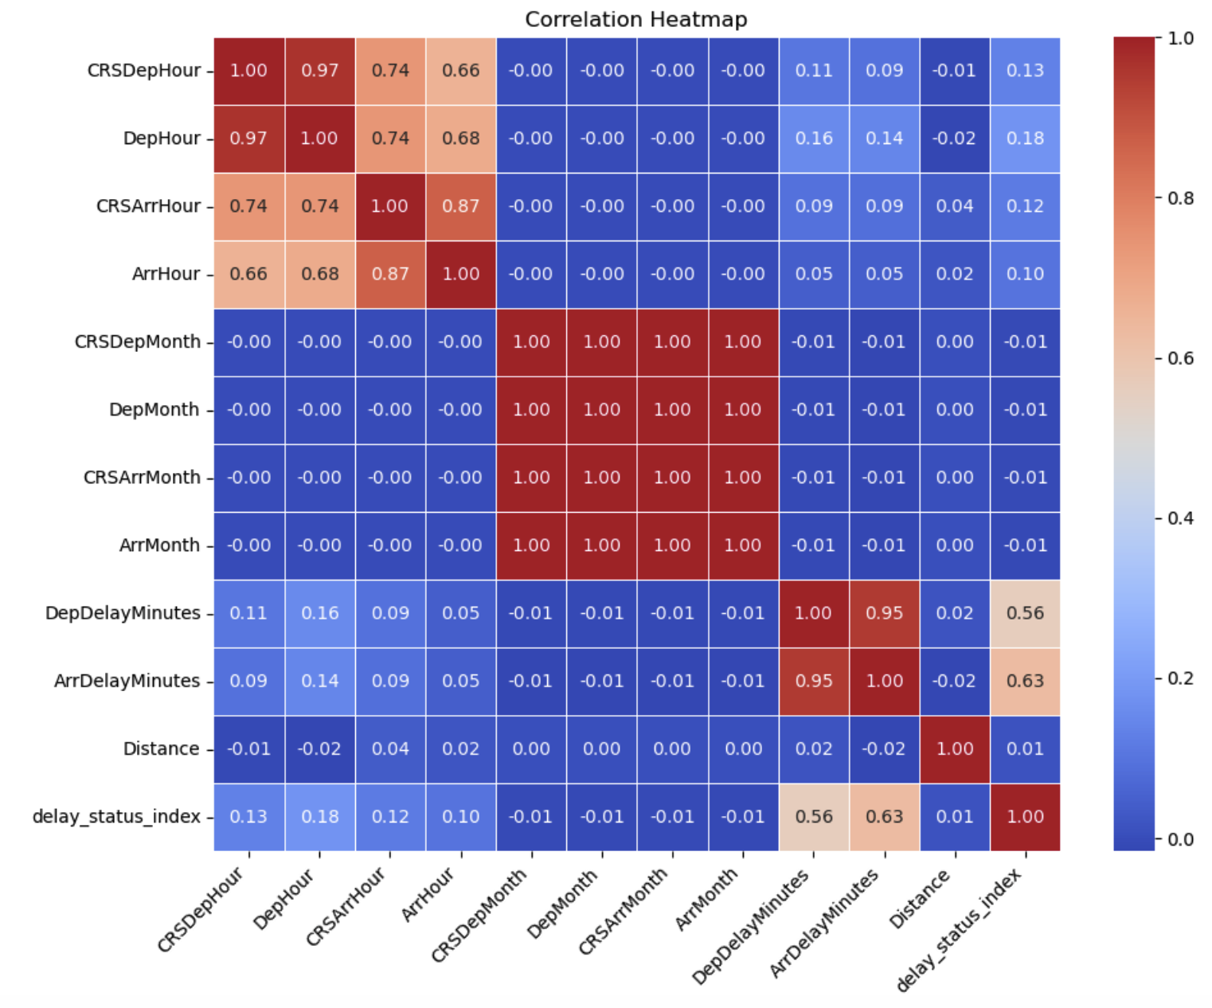
Correlation Heatmap
PROJECT OVERVIEW EDA MODELS BUILDUP BUSINESS INSIGHTS
Other Features:
All variables have low correlation with delays; indicating that there is no clear linear relationship with whether a flight is delayed
* Correlation measures linear trend between two factors. Since the seasonal changes of delay rates, and the hourly changes over a day are non linear, their correlations are low.
Target features:
define delay_status

Slide 17
ANALYSIS II.
Modeling Buildup: Machine Learning

Slide 18

Machine Learning Models
PROJECT OVERVIEW EDA MODELS BUILDUP BUSINESS INSIGHTS
Objective: Predict whether a flight will be Delayed or OnTime
Predicted Variable: Status- Delayed and OnTime (ArrDelayMinutes > 15 min)
Input Variables:
Origin_avg_delay
Average delay for the origin airport
Dest_avg_delay
Average delay for the destination airport
Raw labels for Origin, Destination, and Airline are identifiers without meaningful numerical value. By calculating their average delays, we derive features that correlate directly with flight delay outcomes.
Airline_avg_delay
Average delay for the airline
Distance
Scaled flight distance
FlightDate_numeric
Numerical representation of the flight date
Balance Data, Hyperparameter Tuning, Cross Validation

Slide 19
Logistic Regressions
PROJECT OVERVIEW EDA MODELS BUILDUP BUSINESS INSIGHTS
TRAINING DETAILS
Feature Column
Combined features vectorized as features
Label Column
Status encoded as “status_index”
Balance Data
Assigns class weights to handle class imbalance in the dataset
Hyperparameter Tuning
regParam (0.01, 0.05, 0.1, 0.2) and elasticNetParam (0.0, 0.5, 1.0)
Validation
3-fold cross-validation
Key Result
82.76%
Accuracy:
Notes:
Dest_avg_delay: 0.03370974642166631
Origin_avg_delay: 0.03238721152013727
Airline_avg_delay: 0.019291728253754012
scaled_Distance: 0.010310349430979585
FlightDate_numeric: -3.586314574031476e-10

Slide 20
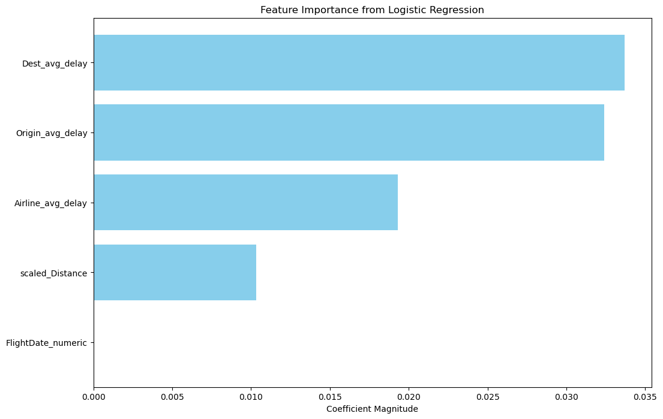
Logistic Regressions
PROJECT OVERVIEW EDA MODELS BUILDUP BUSINESS INSIGHTS
FEATURE IMPORTANCE
Notes:
Dest_avg_delay: 0.03370974642166631
Origin_avg_delay: 0.03238721152013727
Airline_avg_delay: 0.019291728253754012
scaled_Distance: 0.010310349430979585
FlightDate_numeric: -3.586314574031476e-10

Slide 21
Random Forest Model
PROJECT OVERVIEW EDA MODELS BUILDUP BUSINESS INSIGHTS
TRAINING DETAILS
Why RFM
Captures complex, non-linear relationships between features and outcomes
Input Variables
Dest_avg_delay, Origin_avg_delay , Airline_avg_delay, scaled_Distance, FlightDate_numeric
Key Result
Accuracy: 48.9%
The performance of Random Forest was limited by the lack of detailed features such as weather conditions and passenger load. Without these data, the model is unable to calculate for these critical external influences. Random Forest’s reliance on feature richness and variance makes it less effective in this case.
Future improvements will include these factors to enhance predictive accuracy.
Limitations
Notes:
Robust to outliers in the input features because tree splits are based on thresholds, not mathematical equations.
The dataset’s simplicity might favor Logistic Regression, which performs well with fewer features.

Slide 22
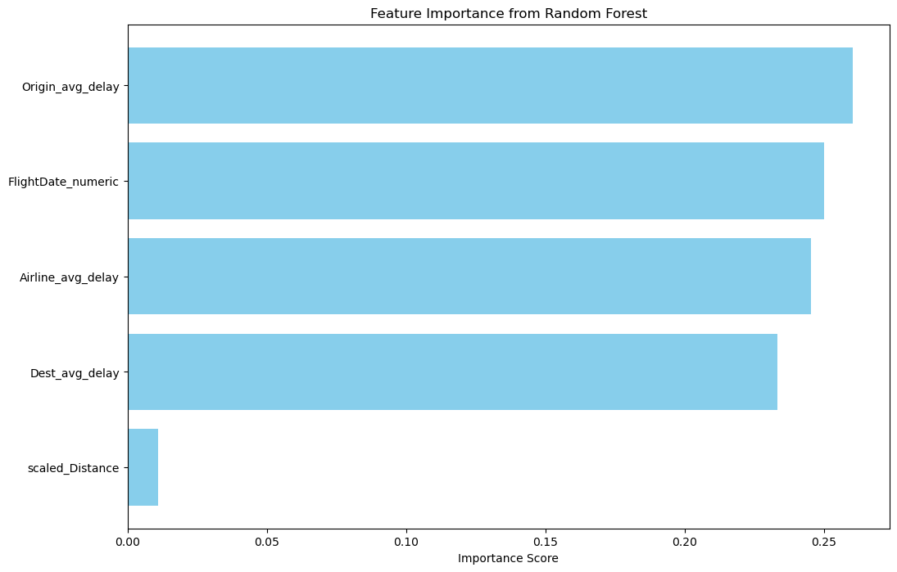
Random Forest Model
PROJECT OVERVIEW EDA MODELS BUILDUP BUSINESS INSIGHTS
FEATURE IMPORTANCE
Notes:
FlightDate is an important feature, as anticipated from our previous EDA and modeling efforts.

Slide 23
ANALYSIS III.
Modeling Buildup: Graphy Analysis

Slide 24
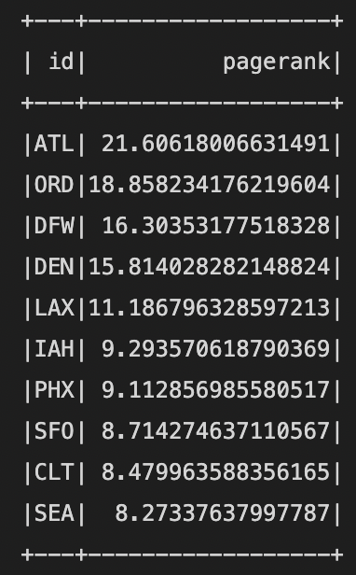
Graphy Analysis
PROJECT OVERVIEW EDA MODELS BUILDUP BUSINESS INSIGHTS
PAGERANK SCORES FOR KEY AIRPORTS
High Scores (e.g., ATL, ORD, DFW)
If these airports face disruptions (weather or technical issues), its central role could lead to widespread delays. Use this ranking to identify alternative rerouting hubs with sufficient capacity such as DEN or LAX
For airports with lower scores, we want to ensure adequate feeder flights to connect them with high-ranking hubs
Notes:
These airports handle a significant amount of traffic and are central hubs in the network.
Identifying Key Connections, Optimizing Resource Allocation
graphframe analysis for this project is ideal because it enables the representation and exploration of flight data as a network of interconnected entities

Slide 25
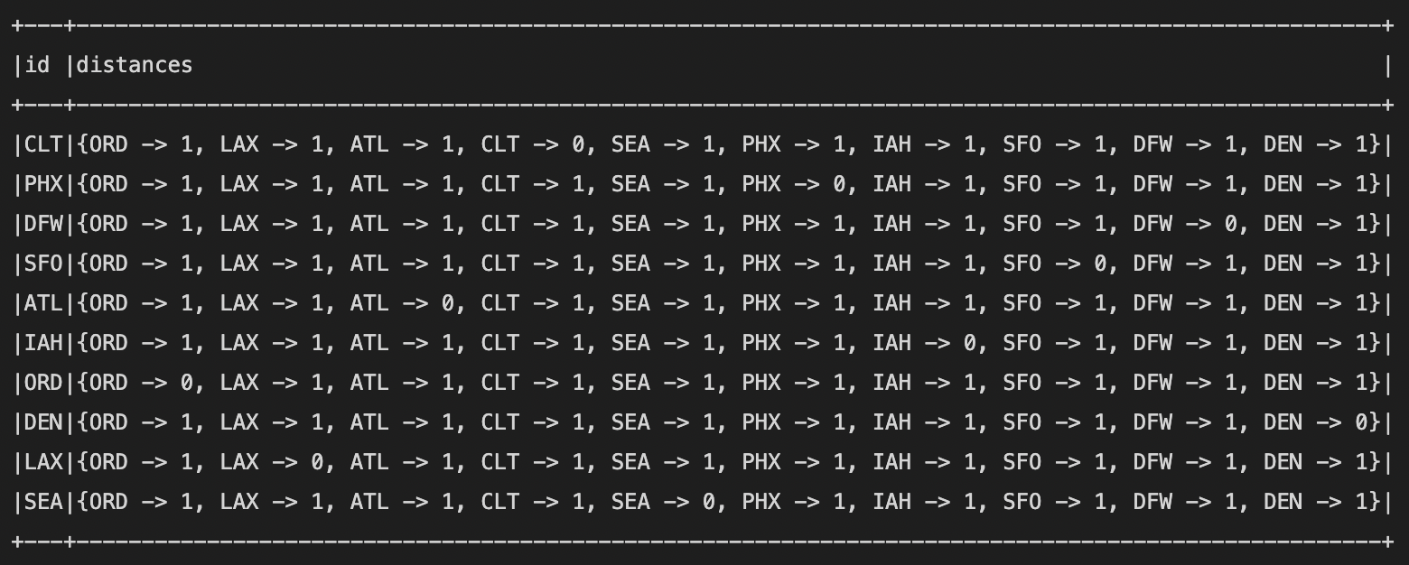
Graphy Analysis
PROJECT OVERVIEW EDA MODELS BUILDUP BUSINESS INSIGHTS
SHORTEST PATHS BETWEEN TOP-RANKED HUBS
Scenario of Disruption:
If the direct flight from PHX to ORD is unavailable (distance = 0)
Re-route:
PHX → DFW → ORD
(total distance = 1 + 1 = 2)
Reliability During Disruptions: In events such as weather disturbances or pandemics, the most efficient routes between major airports can help airlines make decisions to reroute flights quickly and efficiently.
Resource Allocation: It allows airline companies to allocate resources like fuel, staff, and aircraft to the routes that are most crucial for maintaining overall network efficiency, especially during critical periods
Notes:
For example, First line: This shows the shortest distances from CLT to other airports, ORD -> 1: Chicago O'Hare (ORD) is 1 step away.

Slide 26



Business Insights from EDA
PROJECT OVERVIEW EDA MODELS BUILDUP BUSINESS INSIGHTS
Delay-prone airlines are often budget carriers.
Recommendation: Avoid cheap airlines when minimizing delay risk is critical.
High delays: Midnight–3 AM and 6–8 PM.
Lowest delays: 6–7 AM (early morning flights).
Most delays are within one hour, even during high-delay periods.
Recommendation: Opt for early morning flights
Delays spike during holidays and summer months.
Recommendation: Allow extra time for travel during peak seasons.

Slide 27
Business Insights from EDA
PROJECT OVERVIEW EDA MODELS BUILDUP BUSINESS INSIGHTS
Logistic Regression Insights
PageRank Analysis
Shortest Path Analysis
Key predictors influencing delays, such as Destination Average Delay, Origin Average Delay, and Airline Average Delay have strong predictive powers
Prioritizing resource allocation to reduce delays at historically problematic destinations, improving airline schedules, and enhancing communication strategies can significantly enhance efficiency and passenger satisfaction.
Central hubs: ATL, ORD, DFW
Identifies critical airports that serve as central hubs in the network. These hubs can receive higher priority for resource allocation, such as additional staff, aircraft, or enhanced maintenance schedules. For instance, ATL, ORD, and DFW rank highest in PageRank scores, highlighting their importance in the network.
Understanding the shortest paths between major airports helps optimize rerouting during disruptions, reducing passenger inconvenience and delays. Highlighting connections between key airports (e.g., CLT, ATL, LAX) can improve route planning, boost efficiency, and cut fuel costs.

Slide 28
Thank You!

Slide 29
Appendix

Slide 30
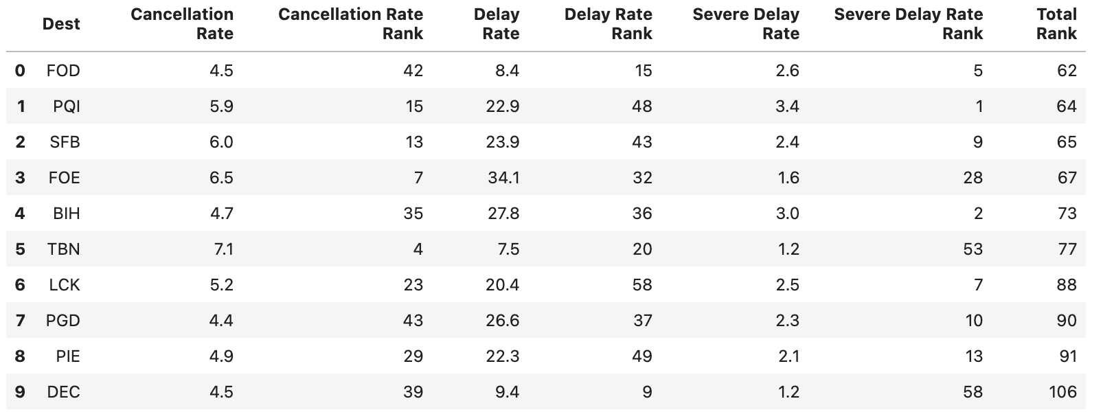
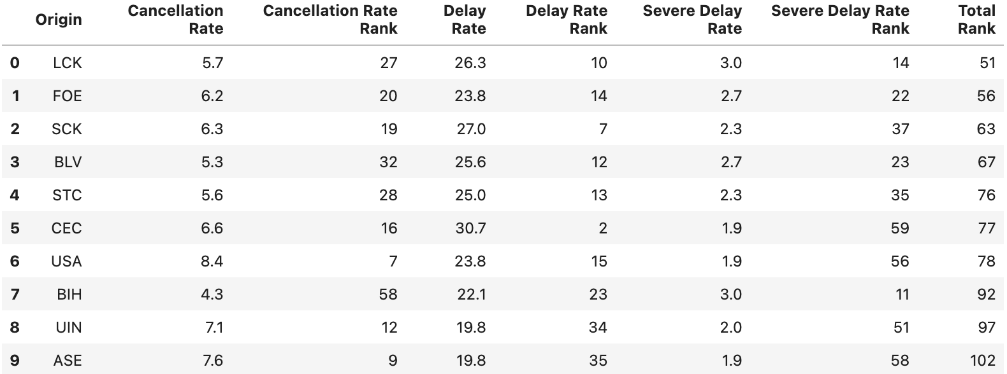
Cancellation/Delay Rate By Airport
PROJECT OVERVIEW EDA MODELS BUILDUP BUSINESS INSIGHTS
Notes:
In this slide, we’re looking at the cancellation and delay rates by airport. The table provides the rankings for each airport in terms of cancellation rate, delay rate, and severe delay rate. As we can see, different airports show varying levels of performance.
FOD and FOE are notable for having high cancellation and delay rates, with both airports ranking near the top for delays and severe delays, suggesting these airports experience more operational disruptions.
SFB also shows high delay rates, and its severe delay rate ranking is fairly significant as well.
Other airports like TBN, PGD, and LCK have more mixed results, but they tend to perform better in terms of severe delays compared to other airports.
The finding here is that, unlike airlines, the cancellation, delay, and severe delay rates at airports seem to be independent of one another. This indicates that a high cancellation rate at an airport doesn't necessarily mean it will also have high delay or severe delay rates.
This insight suggests that passengers wouldn’t have to avoid certain arriving airports solely due to cancellation or delay performance, as these factors don’t appear to influence each other at the airport level.

Slide 31
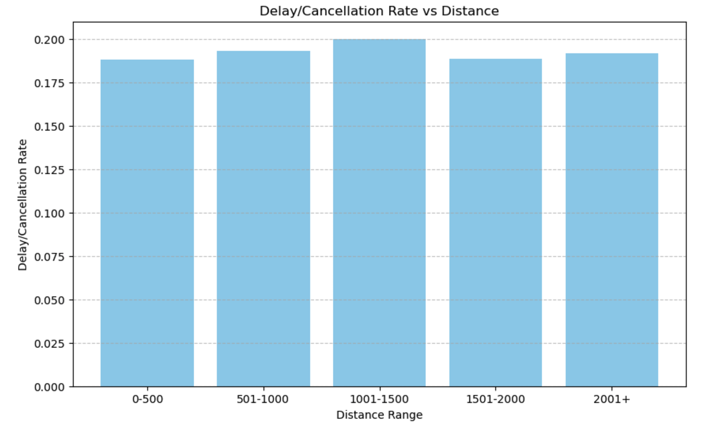
Distance Between Airports
no clear correlation

Slide 32
Correlation Heatmap
delay status has a moderate correlation with delay duration

Slide 33
Why FlightDate Was Excluded as a Predictor in Logistic Regression
What we did for FlightDate:
For the model, we transformed the FlightDate feature into Month and Season to capture potential temporal patterns affecting flight delays. However, the linear relationship assumed by the Logistic Regression model may not fully capture the cyclic nature of these variables (e.g., December is adjacent to January), leading to negative coefficients that suggest reduced delay likelihood during certain months or seasons.
Possible Future Improvement:
To address this, cyclic encoding (using sine and cosine transformations) or categorical encoding (e.g., one-hot encoding) can better represent the temporal patterns, ensuring the model interprets these features accurately and improves predictive performance.

Slide 34
Peak Times of Delay By Airport
PROJECT OVERVIEW EDA MODELS BUILDUP BUSINESS INSIGHTS
By airport where the flight is departing from
Top 5 Busiest Airports
Atlanta (ATL)
Denver (DEN)
Dallas (DFW)
Los Angeles (LAX)
Chicago (ORD)
Departure Hour:
High Delay Period: Midnight - 3 AM; 6 PM - 8 PM
Early morning flights 3-5 AM) have the lowest delay rates.
Peak delay patterns are consistent across top airports
Notes:
We identified the top 5 busiest airports by calculating the volume of incoming and outgoing flights, and here we look at the delay/cancellation patterns for flights departing from these airports. The peak and off-peak delay patterns are consistent across all airports, and is also consistent with the general trend.

Slide 35
Peak Times of Delay By Airport
PROJECT OVERVIEW EDA MODELS BUILDUP BUSINESS INSIGHTS
By airport where the flight is arriving at
Arrival Hour:
High Delay Period: Midnight - 3 AM; 6 PM - 8 PM
Early morning flights 6-7 AM have the lowest delay rates.
Peak delay patterns are consistent across top airports
Passengers can avoid booking peak-hour flights to reduce the risk of delays and cancellations.
Notes:
This graph shows the delay/cancellation pattern for flights arriving at the top 5 airports. There is a slight shift in off-peak arrival times comparing to departure patterns, but this makes sense because it takes a few hours for a flight to reach to its destination. Other than that, still very similar trends. For passengers who want to minimize the risk of delays and cancellation, they can choose early morning flights, or avoid booking flights that depart or arrive during peak hours.

